Slide 1
Identifying immune cell subsets associated with immune-related adverse event (irAE) development
12-19-2024
Ty Bottorff – Bioinformatics postdoc
Linsley lab

Slide 2

Acknowledgements
Peter Linsley
Long lab/HIPcore
Alice Long, Alice Wiedeman
Holly Akilesh
Buckner lab
Jane Buckner, Sylvia Posso, Cliff Rims
Bernard Khor
Bioinformatics
Hannah DeBerg
Basilin Benson
Andrew Koval
Clinical team

Slide 3
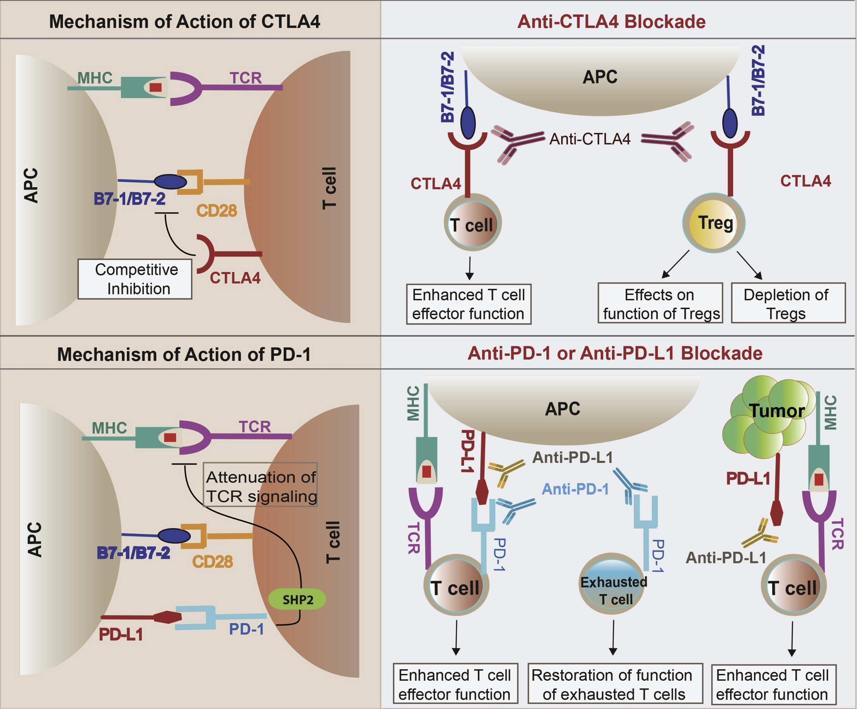
Immune checkpoint inhibitors (ICIs) have revolutionized cancer treatment
Khan et al. Semin Cancer Biol. 2020
Notes:
Despite the clinical successes of immune checkpoint inhibitors (ICI), they are only effective in some patients,
with response rates in the 20-50% range (1). Typically, there is a fraction of patients that show no objective
response (OR) (2-4).
The mode of action of immune checkpoint inhibitors is through blockade of inhibitory molecules involved in the regulation of T cells, thus releasing tumor specific T cells to destroy their tumor targets.

Slide 4
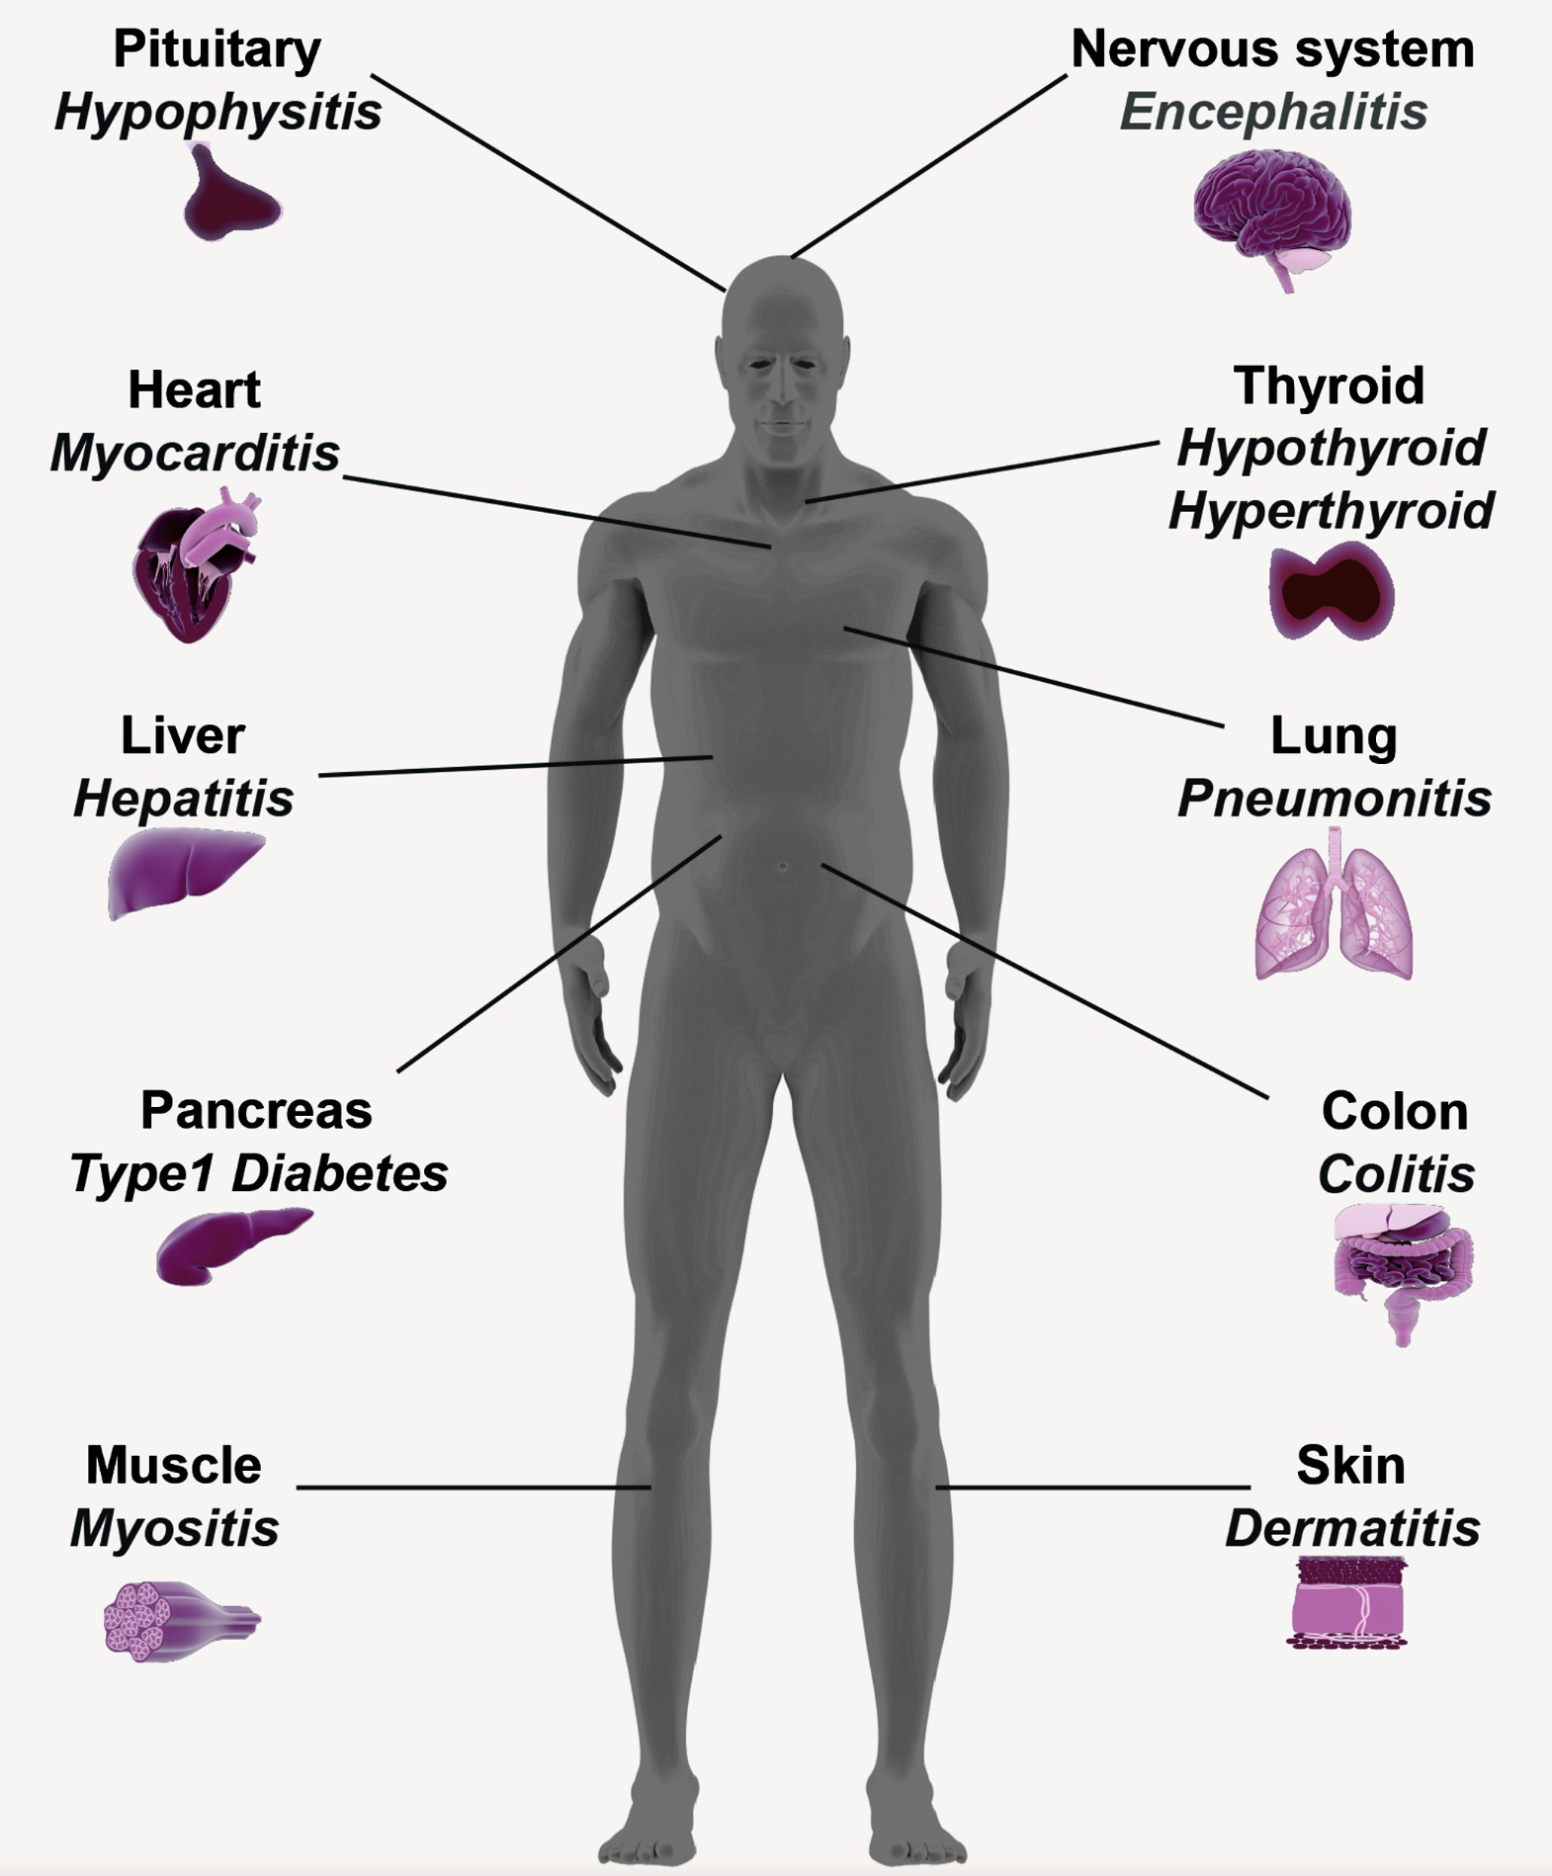
However, ICIs can lead to the development of immune-related adverse events (irAEs)
Khan et al. Semin Cancer Biol. 2020
Notes:
However, ICI can
also lead to a breach in self-tolerance resulting in immune-related adverse events (irAE) that include tissue
specific autoimmunity. Notably, irAE are quite heterogeneous, and in some studies have been associated with
therapeutic benefit.
serious immune-related adverse events (irAE) have been associated with ICI
therapy. These events include colitis, pneumonitis, neuropathies, endocrinopathies, nephritis, dermatitis and
arthritis (5-26). Multiple reports have suggested that irAE are associated with favorable clinical responses to
ICI (27-34). Most importantly, these adverse events affect quality of life and can lead to discontinuation of ICI,
which in turn does not allow the patient to fully benefit from ICI therapy
irAEs are autoimmune-like inflammatory pathologies, more transient though

Slide 5
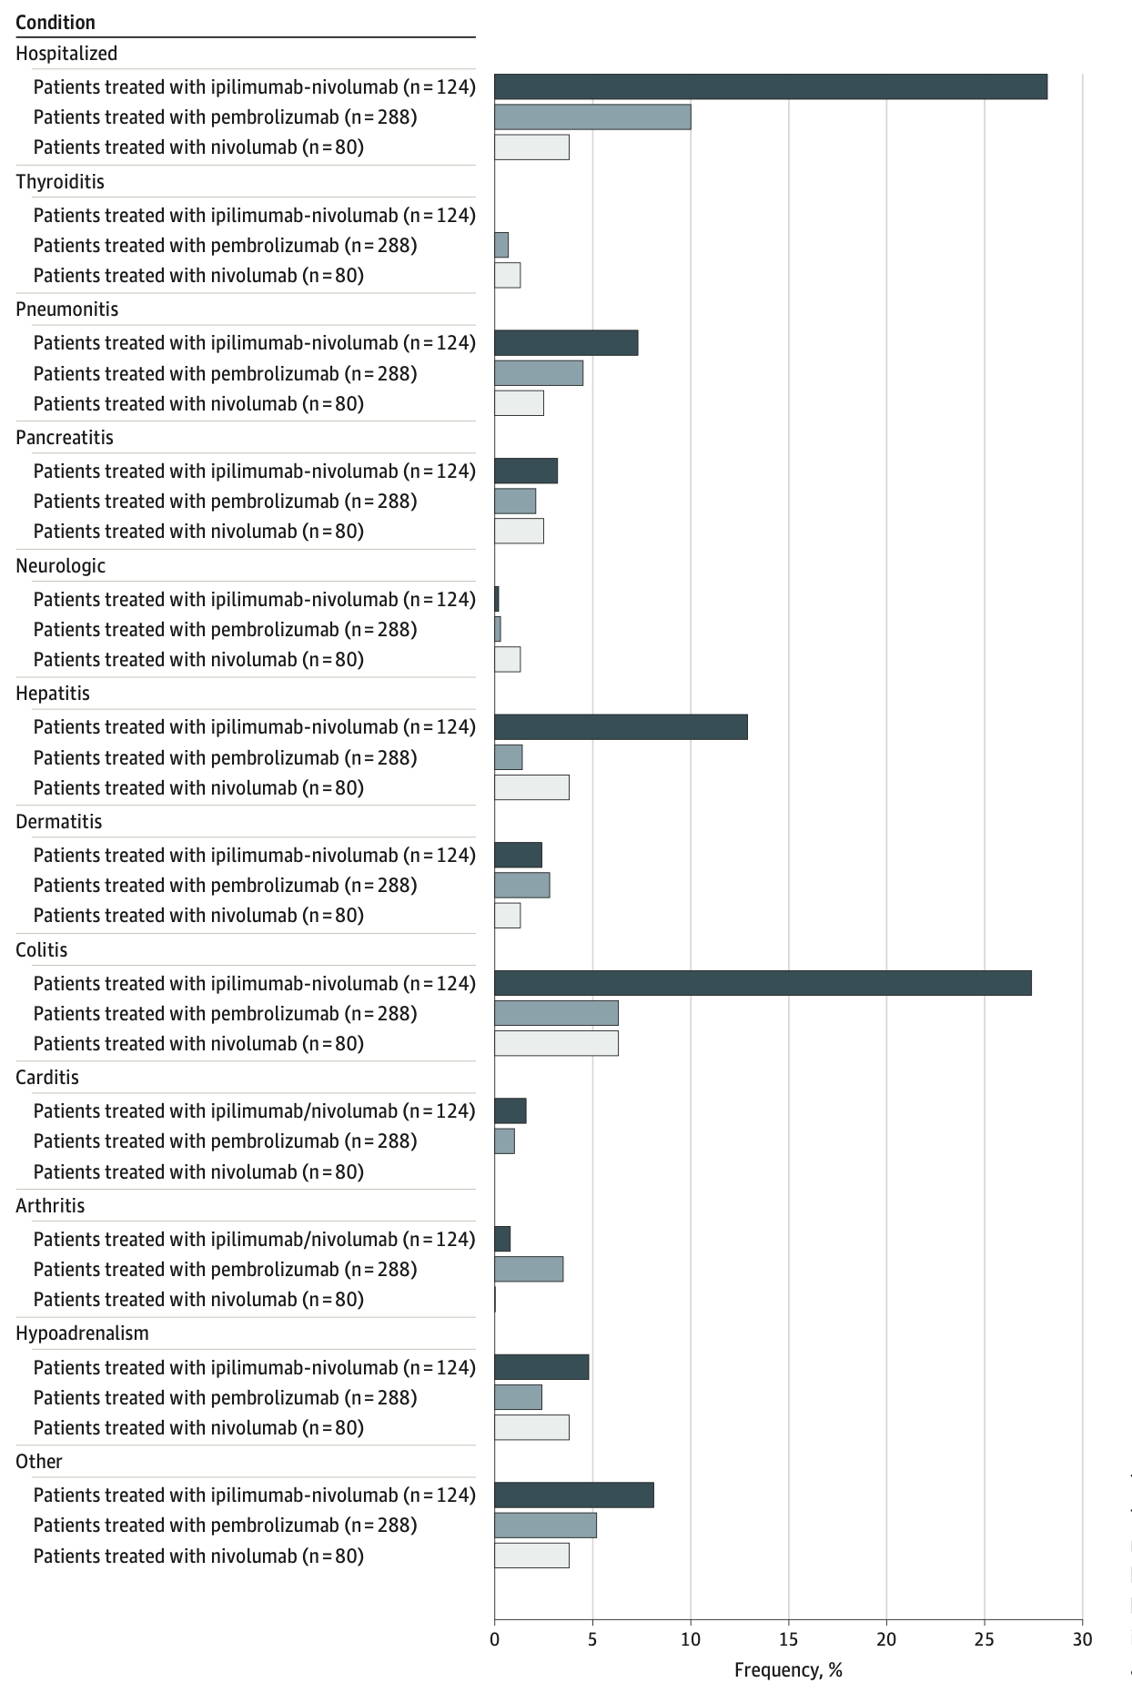
irAEs are rather common and can be severe
Watson et al. JAMA Netw Open. 2022
Notes:
T cell characteristics associated with toxicity to immune checkpoint blockade in patients with melanoma
Autoimmune toxicity occurs in up to 60% of patients treated with immune checkpoint inhibitor (ICI) therapy
Ipilimumab: CTLA-4
Pembrolizumab/nivolumab: PD-1

Slide 6
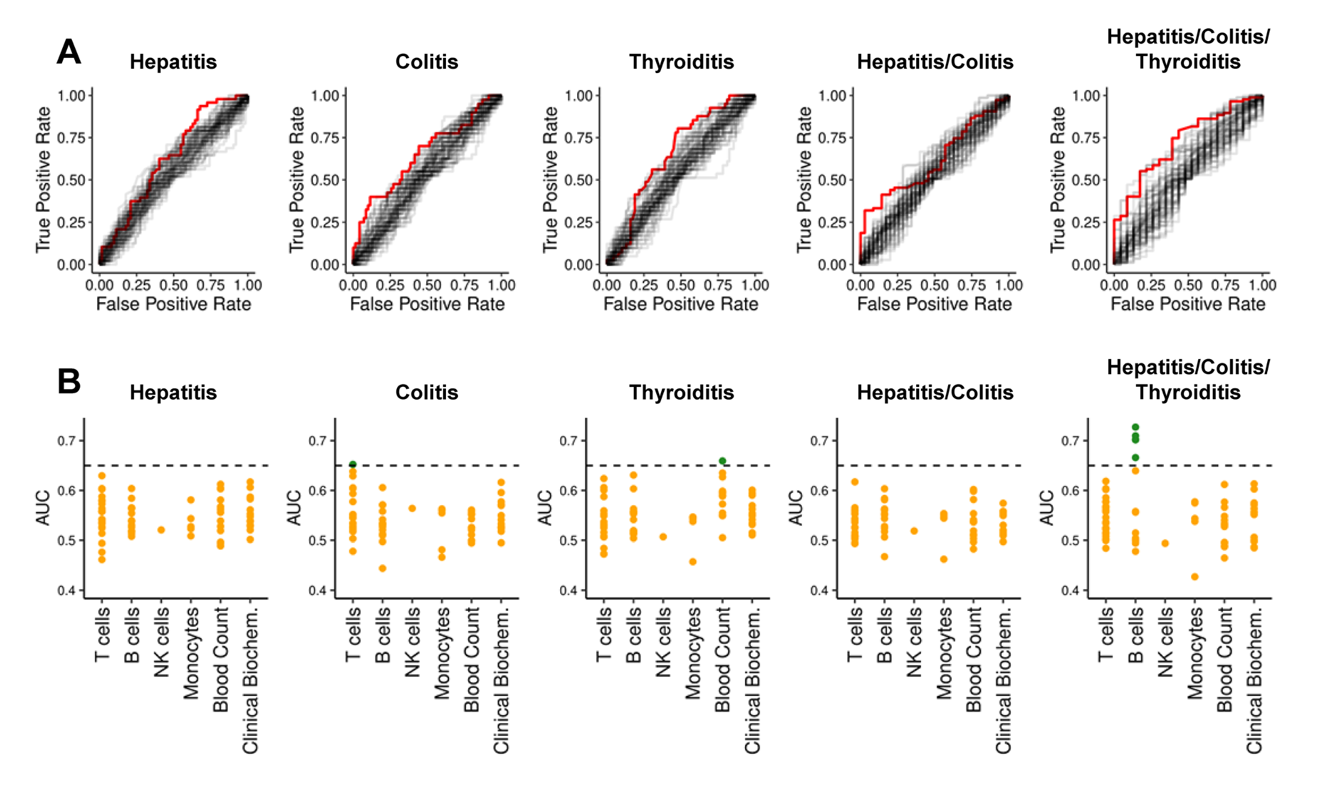
Pre-therapy data generally struggle to reliably predict irAE risk
AUCs for previously reported biomarkers and clinical parameters (68)
Glehr et al. Front Immunol. 2022
Notes:
Biomarkers associated with irAE
have also been described, including IL-17 levels, gene expression signatures and levels of eosinophils
T cells are implicated in the irAE associated with ICI. Clonal expansions of CD8 T
cells are seen prior to grade 2-3 irAE (44). There are also increasing reports of irAE that are T cell mediated
autoimmune diseases typically occurring within 8-12 weeks of ICI initiation. These include multiple case reports
of ICI-induced type 1 diabetes (T1D) typically presenting as ketoacidosis, persistent impairment of C-peptide,
and the development of islet autoantibodies and islet specific CD4 T cell responses (9-15). Rheumatoid
arthritis (RA) has also been described after ICI (16-22), and in several cases anti-citrullinated protein
antibodies (ACPAs) were present (20, 22). Similarly, autoimmune thyroiditis (13, 23, 24) and vitiligo are
described with ICI therapy (26). In addition, individuals with preexisting autoimmune disease flare when treated
with ICI (22, 25). In summary, T cells are central to the process of therapeutic response and autoimmune
adverse events related to ICI, and as noted above these two outcomes may in fact be related.
An AUC of 0.5 suggests no discrimination (equivalent to random guessing), while an AUC of 1 indicates perfect discrimination (for predicting irAE)
heterogeneity amongst irAE organs likely complicates prediction
Germline variants associated with toxicity to immune checkpoint blockade: IL7 cryptic exon, IL7 supports aberrant immune activity in autoimmunity, limits organ toxicity during antiviral immune response, blocks PD-1 leading to T1D (blocking checkpoint when it would have prevented autoimmunity, so IL7 acts as a natural ICB and is therefore rationally associated with irAEs
lower baseline levels of CD8 TCM cells in arthritis irAE patients, higher CD4 Th2 baseline levels in pneumonitis irAE patients, higher CD4 Th17 baseline levels in thyroiditis irAE patients (PMID: 36513074)
low baseline circulating MAITs associated with irAE colitis (PMID: 32734627, ~coincides with my analysis)
activated CD4 TEM abundance (in PBMCs) associated with irAE development (PMID: 35027754, ~disagrees with my analysis)
T cell characteristics associated with toxicity to immune checkpoint blockade in patients with melanoma: BASELINE activated CD4 effector memory T abundance and TCR diversity associated with irAE
# Germline genetic variants are associated with development of insulin-dependent diabetes in cancer patients treated with immune checkpoint inhibitors
- *NLRC5* germline mutation as potential predictive biomarker for T1D irAE

Slide 7
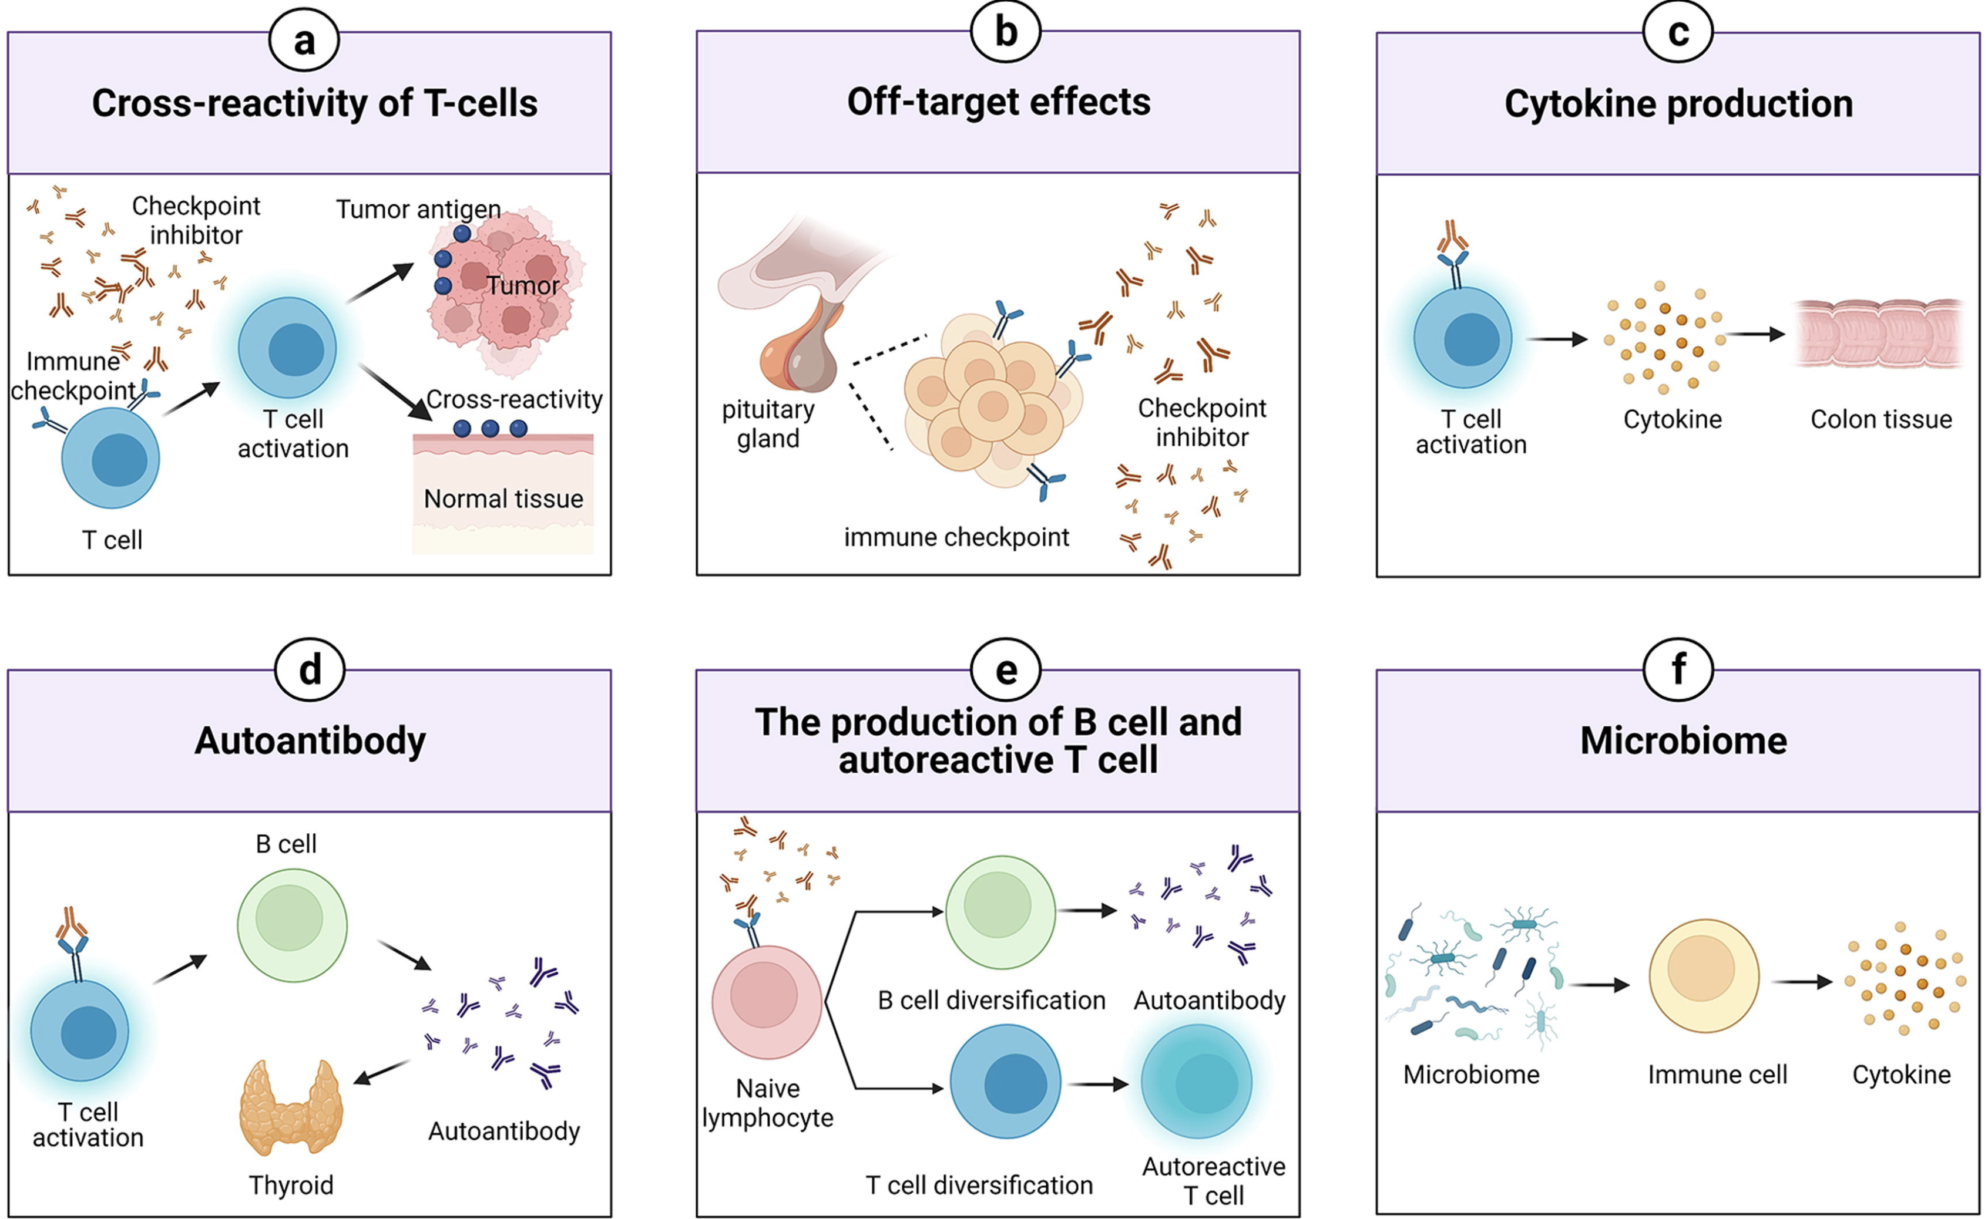
irAEs may be driven by multiple, possible mechanisms
Zheng et al. Materials & Design. 2022
Notes:
TCRs estimated to potentially react with 1 in ~10k encountered peptides (PMID37409132)
Killed tumor cells may release antigens shared by normal cells (i.e. non-tumorigenic proteins still in tumor cell), healthy cells around tumor may also be killed in crossfire and release antigens that induce response
Speculation for what crossreactive T cells are actually targeting, perhaps T cells targeting cancer neoantigens cross-react with WT version of protein in healthy tissue (Autoreactive napsin A-specific T cells are enriched in lung tumors and inflammatory lung lesions during immune checkpoint blockade)
Gouttefangeas et al. Front Immunol. 2023
TCR conceivably could recognize ~ 1 million peptides, crossreactive peptides likely often better agonists than original one that activated T cell, but few (~1%) of peptides are actually presented on MHC, so probably crossreactivity estimate closer to 1 in ~10,000
estimate TCRs to be able to bind ~10^5 to 10^6 peptides (Amino acid similarity accounts for T cell crossreactivity and for "holes" in the T cell repertoire)
What makes TCRs crossreactive? cross-reactivity need not result from sequence similarity (3D structural similarity more important than 1D sequence similarity (Peter’s paper: Autoreactive T cell receptors with shared germline-like α chains in type 1 diabetes)
(b) ICIs can target normal tissues such as hypothalamic and pituitary tissues directly which express immune checkpoint ligand
Pituitary expression of CTLA-4 mediates hypophysitis secondary to administration of CTLA-4 blocking antibody
(c) Activated T cells can release inflammatory mediators which lead to damage in normal tissues
(d) The production of autoantibodies is associated with the risk of irAEs. autoantibodies present ~50% of time for irAEs
(e) ICIs can induce the diversification of lymphocytes as well as promoting T/B cell activation and proliferation
(f) The microbiome with certain bacterial species can shift immune lineage to pro-inflammatory or anti-inflammatory subtypes respectively thereby inducing or resisting irAEs
# Advances in research on molecular markers in immune checkpoint inhibitor-associated myocarditis
- irAE hypotheses: ICIs bind to cell surface proteins (like CTLA-4) in normal tissue leading to T cell infiltration (**this is an obvious one I don't think about much**), crossreactive T cells (T cells recognizing tumor antigens enter circulation and identify similar antigens in healthy tissue), via cytokines (promote infiltration of inflammatory molecules into nontarget tissue, ICIs increase circulating cytokine levels, **this is a good one I don't think about much**), autoantibodies
# B cells as biomarkers: predicting immune checkpoint therapy adverse events
- association between early therapy-induced changes in circulating B cells (decreased B cells, increased plasmablasts and CD21<sup>low</sup>PD-1<sup>+</sup> memory B cells) and an increased risk of high-grade irAEs in patients treated with ICB

Slide 8
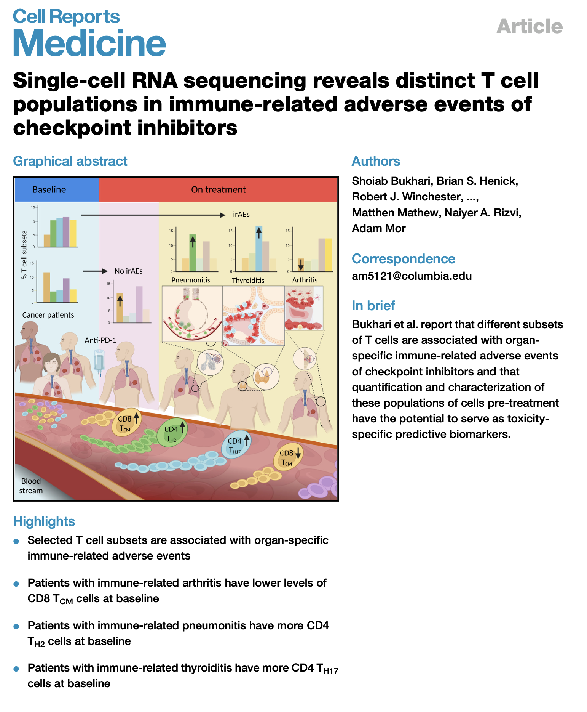
Baseline abundances of different cell types have been associated with different organ irAEs
why subsets irae type specific?
Notes:
lower baseline levels of CD8 TCM cells in arthritis irAE patients, higher CD4 Th2 baseline levels in pneumonitis irAE patients, higher CD4 Th17 baseline levels in thyroiditis irAE patients (PMID: 36513074)

Slide 9
Main goals
Identify immune cell biomarkers that predict irAEs
Determine how ICI alters immune cell landscape

Slide 10
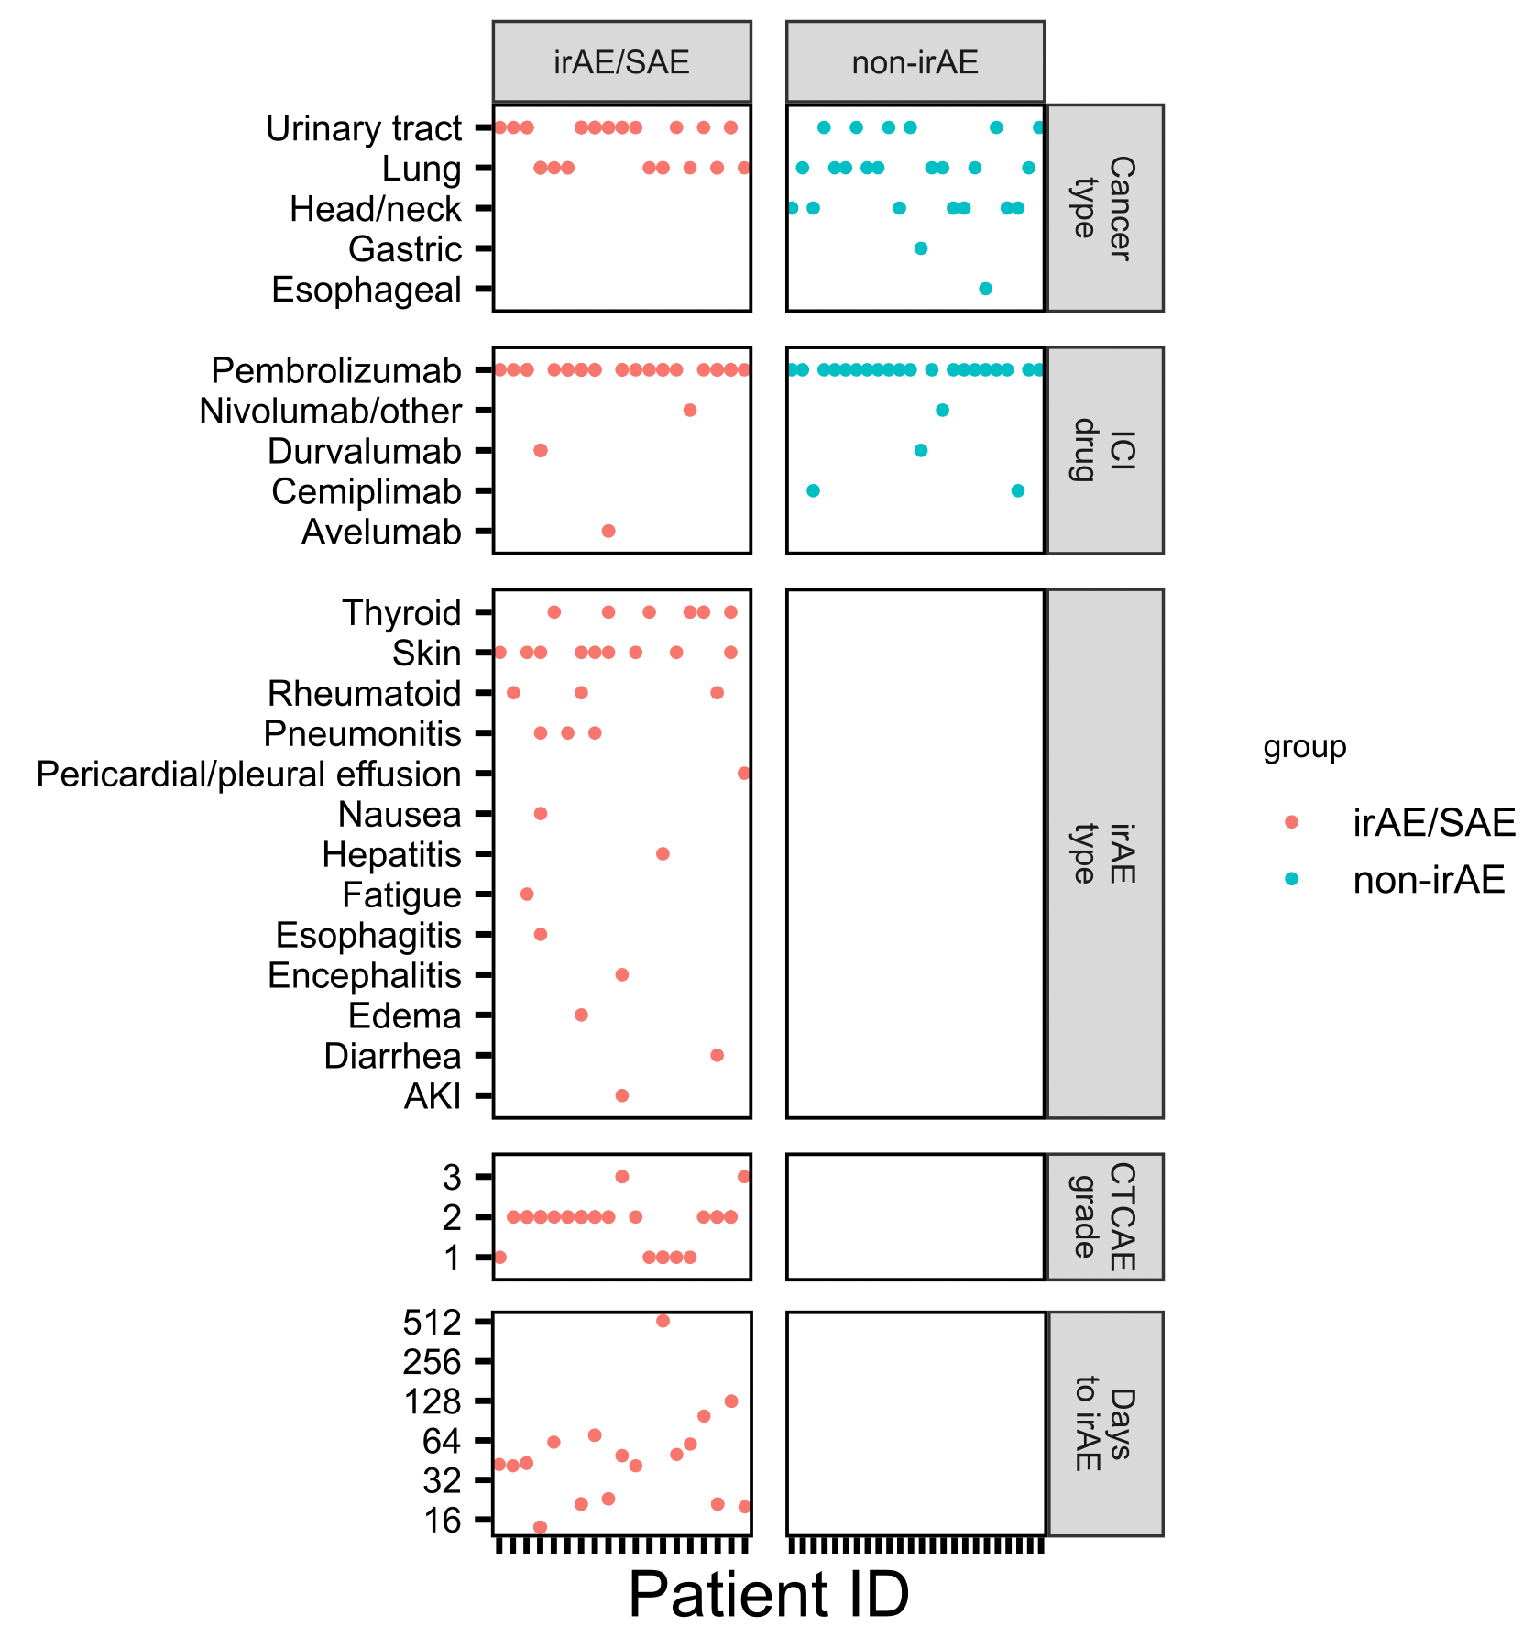
Cancer cohort
mostly lung/urinary tract primary cancers
almost exclusively treated with anti PD-1
skin, thyroid irAEs well-represented
most irAEs arise within 1-2 months
Notes:
focus our efforts on lung and bladder cancer, which are carcinogen-related cancers with a common etiologic risk factor
(tobacco use) and importantly are treated with a single class of checkpoint inhibitors.
focus on PD-1/PD-L1 ICI therapies for solid tumors, specifically non-
small cell lung cancer (NSCLC), and transitional cell carcinoma of the bladder and urinary system (TCC). PD-1
is targeted by drugs including nivolumab, pembrolizumab and cemiplimab, and PD-L1 by atezolizumab,
avelumab and durvalumab. We chose these tumor types because these therapies are the established standard
of care for these malignancies due to durable responses, remissions and improvements in survival (45, 46).
PD-1 ICI therapies are approved in the second-line setting for advanced NSCLC, and TCC and first-line
approval for PD-1 selected NSCLC, and TCC. Furthermore, these tumor types are carcinogen-related cancers
with the common etiologic risk factor of smoking and tobacco use. Importantly, despite some exceptions (41,
47), similar irAEs are seen with PD-1 pathway agents in these tumor types
In response to this rapidly changing landscape of ICI therapy, we have made two simplifying
assumptions about patient populations to study. First, we will treat all PD-1 pathway inhibitors together. Since
PD-1 pathway targeting agents all have similar mechanisms of action and reported similar toxicities, it is
reasonable to expect them to trigger overall similar patterns of target-related irAE. Importantly this will enable
us to have more patients to study as increasing numbers of PD-1 pathway agents enter the clinic. Second, in
addition to patients treated with PD-1 alone, we will include patients treated with PD-1 in combination with
platinum-based chemotherapy as this comprises the standard of care options for first line NSCLC
Durvalumab/avelumab are anti-PDL1
Longitudinal data, draw schedule: visits 2/3 after 1st/2nd infusion (ICI), then some more after irAE development in irAE group
Cancer types important, as that (in addition to irAE types) will likely help explain differences in results between here/public reports (memory CD4 T cells may be more predictive in patients with melanoma while CD8 effecter T cells maye be more associated with a lung cancer population)

Slide 11
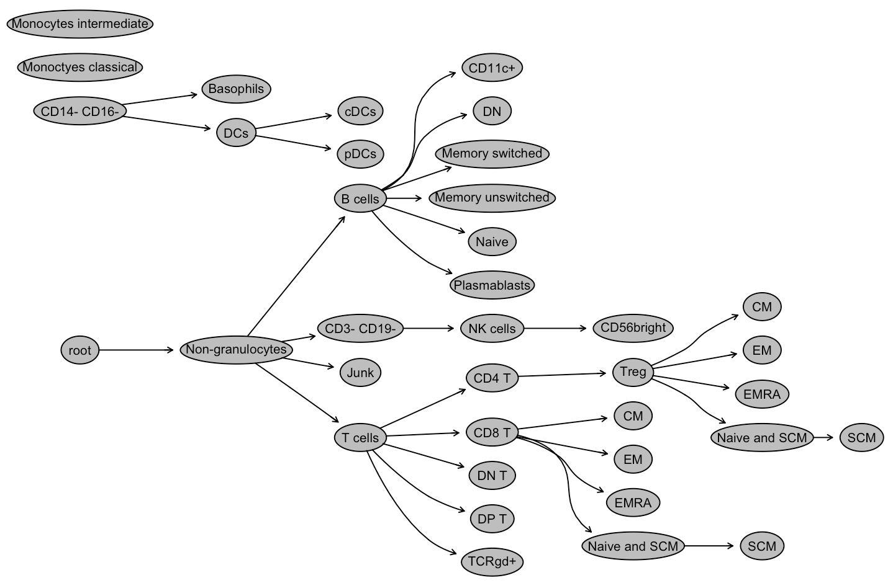
Analyzing immune cell populations with CyTOF
Broad subsets (T, B, NK, monocytes…)
Memory subsets of T/B cells
Special CD4/CD8 subsets
PD1⁺ T/B/NK, PDL1⁺ (monocytes)
Notes:
Mass cytometry
80 reportables* (FlowJo, Alice Wiedeman)
Broad subsets (PMN, T, B, NK, Mono, DC)
Memory subsets of T (Tconv, Treg, CD8) and B
Special subsets of CD4 and CD8 T
PD1 on T/B/NK; PDL1 on Mono
Alice used Astrolabe cytometry cloud platform

Slide 12
Main goals
Identify immune cell biomarkers that predict irAEs
Determine how ICI alters immune cell landscape
Notes:
scientific premise of the proposed studies is that T cell responses to tumor and autoantigens are predictive
of response to ICI therapy and/or irAE. This premise is supported by 1) published studies showing that ICI
therapy targets T cells, 2) emerging evidence that ICI therapy reverses T cell exhaustion, and 3) the growing
number of reports that ICI therapy induce autoimmune disease.
hypothesis that ICI-induced irAEs, similar to flare-ups in patients with primary autoimmunity, are symptomatic exacerbations that occur in the context of a baseline dysregulated immune state unleashed by ICI treatment.
Grant’s central hypothesis: freq/phenotype of T cells specific for self-antigens predicts irAEs

Slide 13
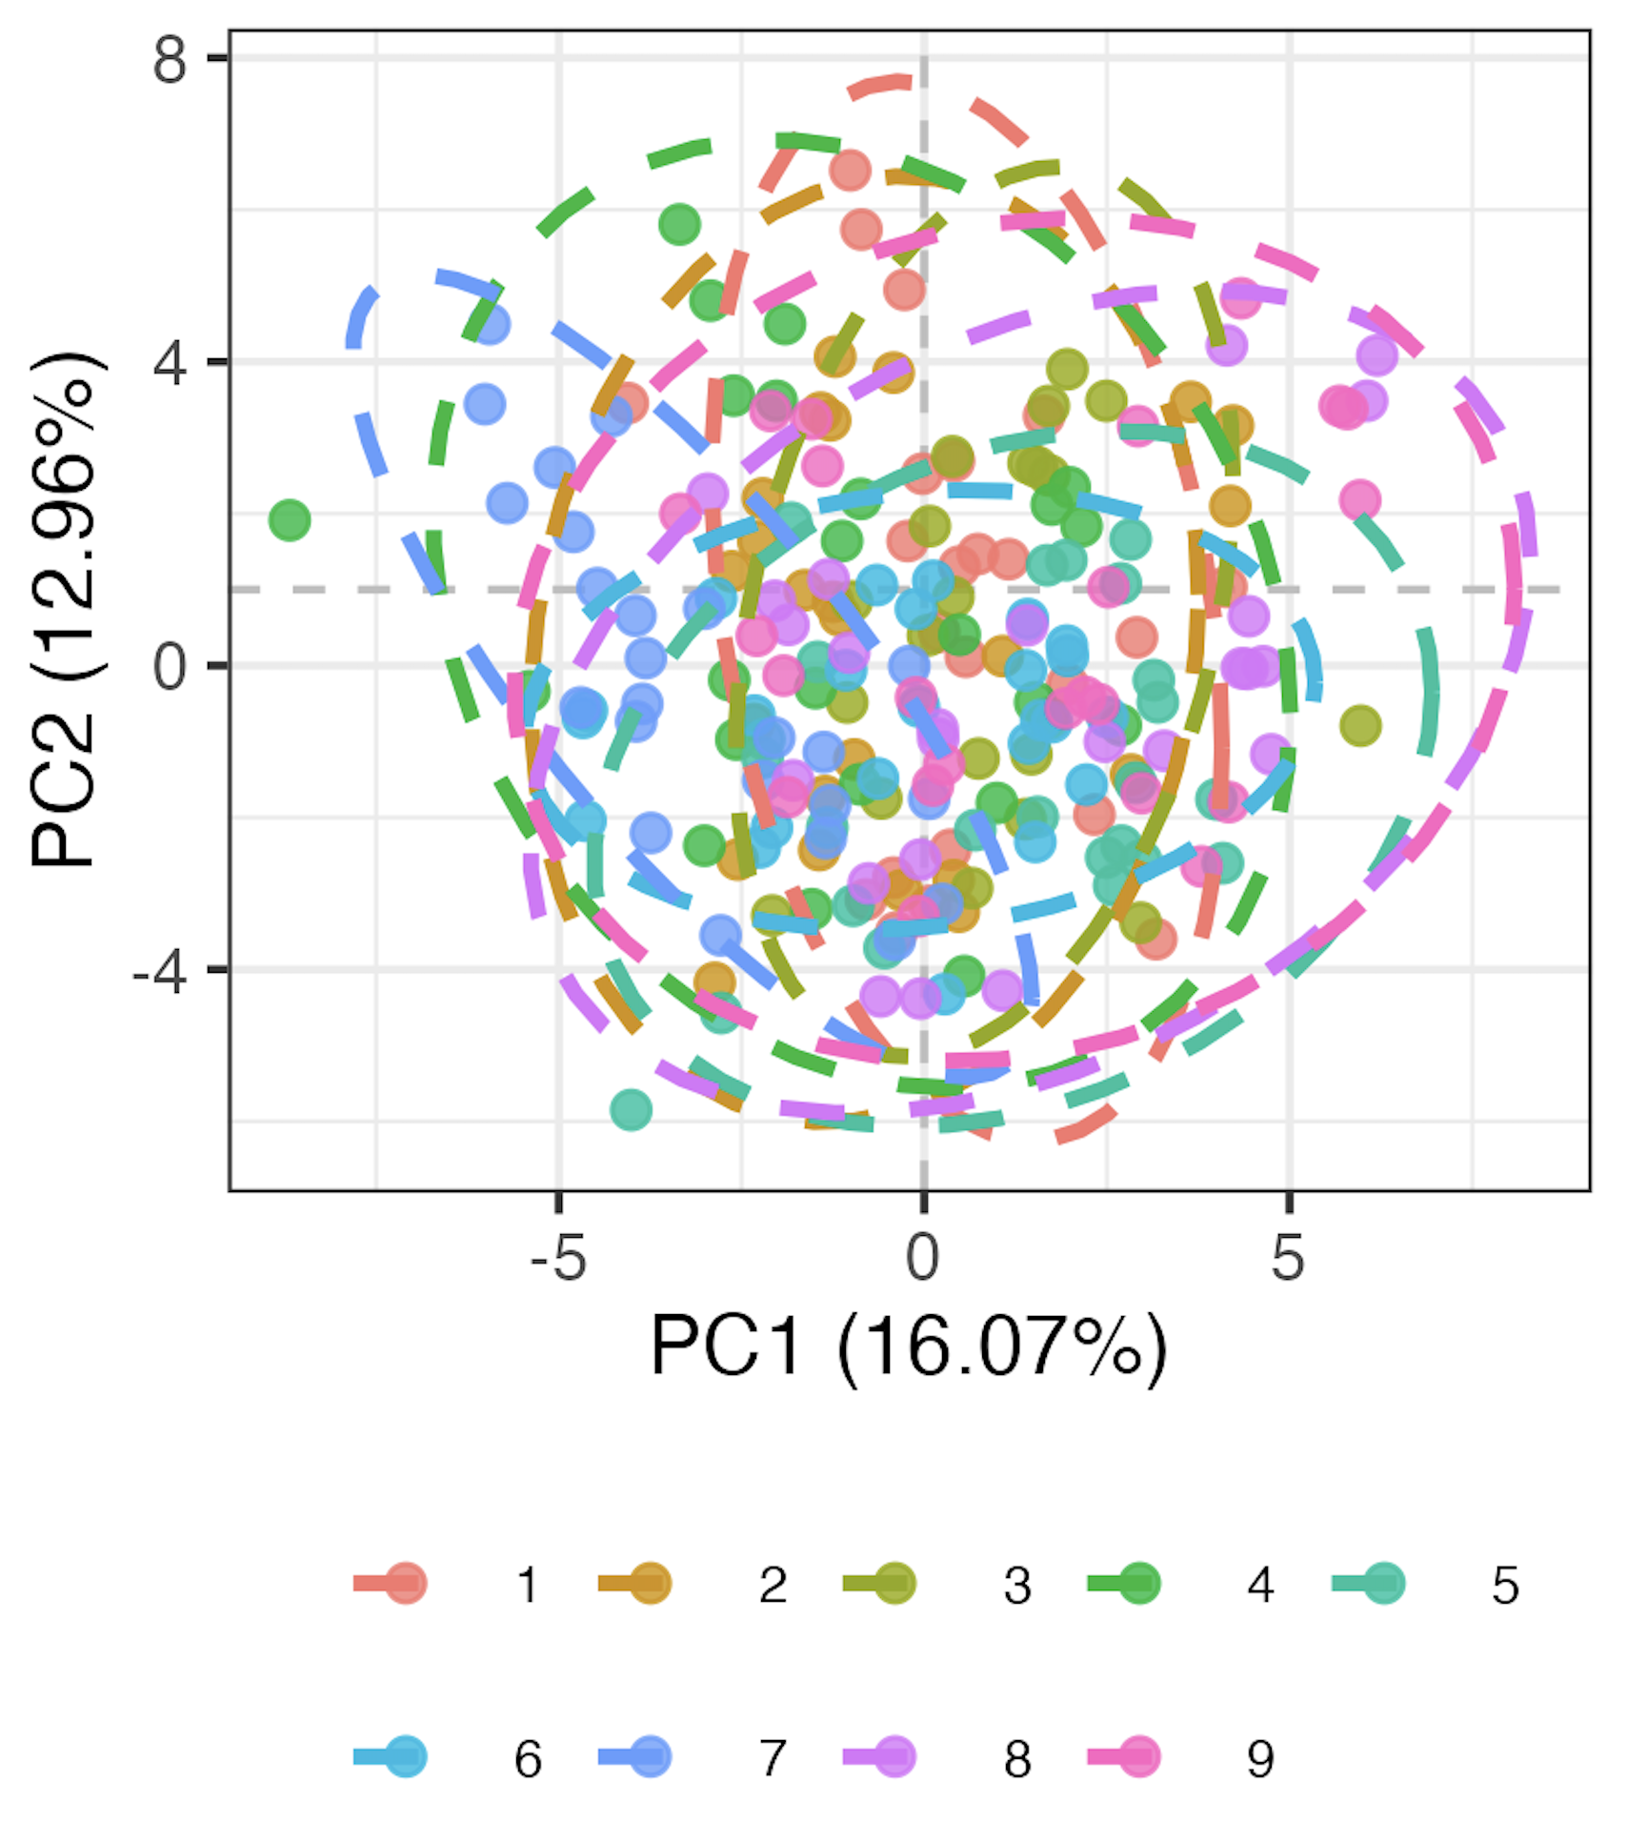
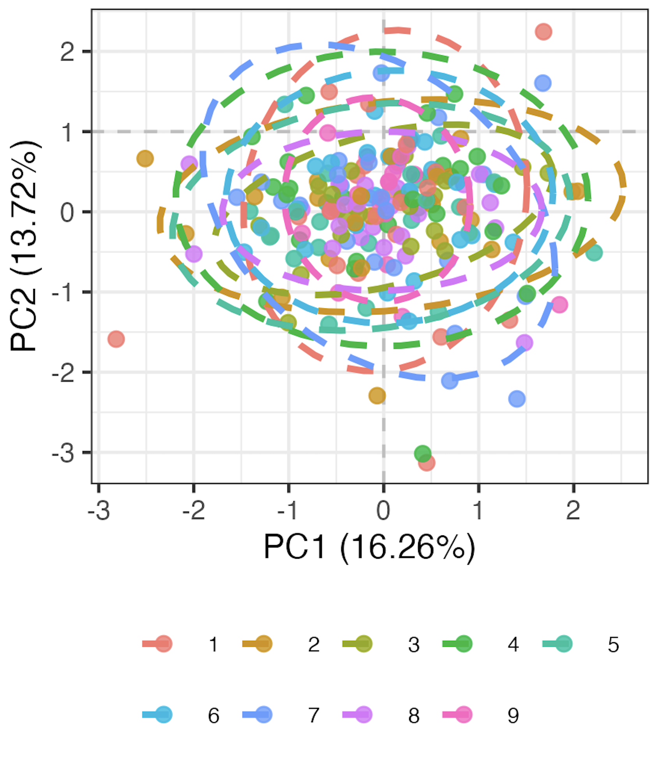
Methods for processing data
Remove 9 features with high technical variation
Normalize percent of parent data
Logit transform, Z-scale
Run mixed-effects LM for each of 71 remaining features, take residuals as batch-corrected data
Pre
Post
model <- lmer(freq ~ batch + (1|patient_id))
Batch
Batch
Notes:
Logit transforms 0-1 to –inf, inf to normalize data
This is likely overcorrecting but no better idea (yet)

Slide 14
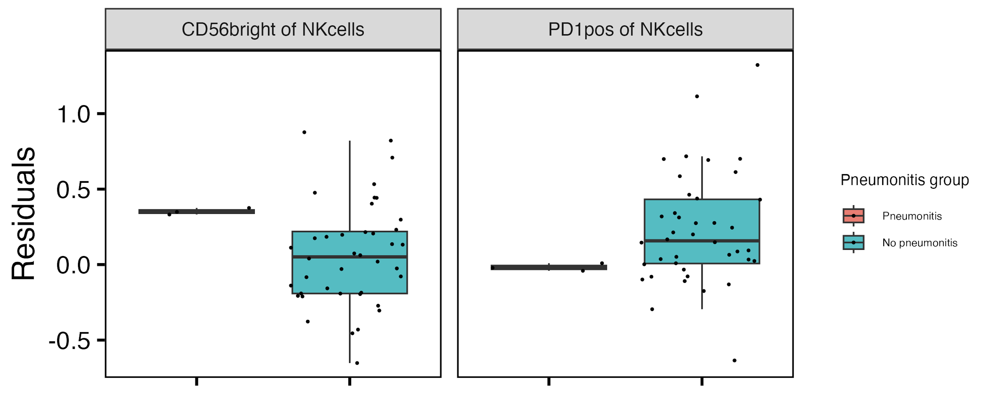
Baseline CD56^{bright} of NK cells frequency higher, PD1⁺ of NK cells frequency lower in those developing pneumonitis
**
**
**: padj < 0.01
Notes:
if including pleural effusion, then PD1+ of NKs drops (padj > 0.05) but it doesn’t matter for CD56bright of NKs
CD56bright NK are abundant cytokine producers but only weakly cytotoxic before activation, PD1+ NK presumably more inhibited…, so these trends make sense with more active → more irAE and more inhibited → less irAE

Slide 15
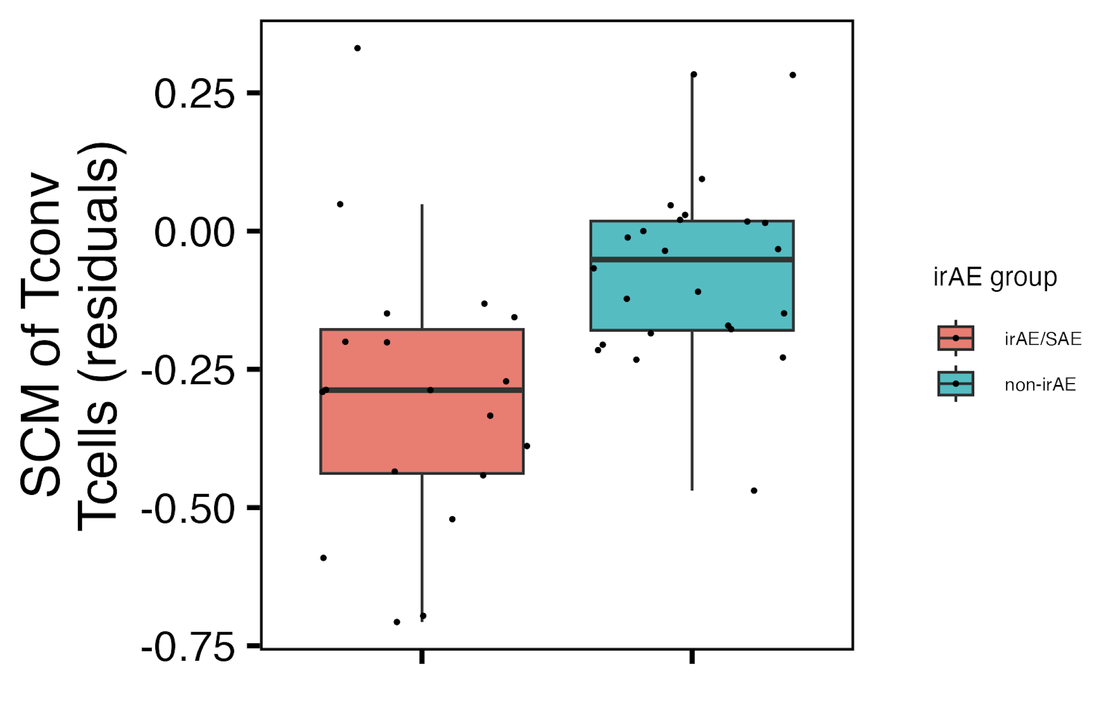
Baseline SCM of T_{conv} T_{cells} frequency may be lower in those developing an irAE
padj = 0.1
Notes:
This may be unexpected… from grant “We expect that phenotypes associated with more
pathogenic autoimmunity (stem cell memory, transitional memory, CXCR3hi T cells, etc.) will expand following
ICI-treatment in subjects with irAE. ”

Slide 16
Methods for baseline feature modules
For each irAE group comparison
Rank features by importance
if irAE group has sufficient n, use random forest models to order features by importance in irAE group distinction
otherwise for each feature test for difference in baseline frequency distributions between irAE groups and arrange by pval
Take top 4 features as top feature model
PCA only using features in the module
Notes:
For features with < 5% NAs, replace NAs with mean
random forest modules may be more robust, maybe more recapitulated in other datasets... that can explain differences between them and original modules (more likely over fit)
Should also emphasize that modules are somewhat arbitrary in sense that multiple different configurations of mostly same features would likely work for each module approach taken here

Slide 17
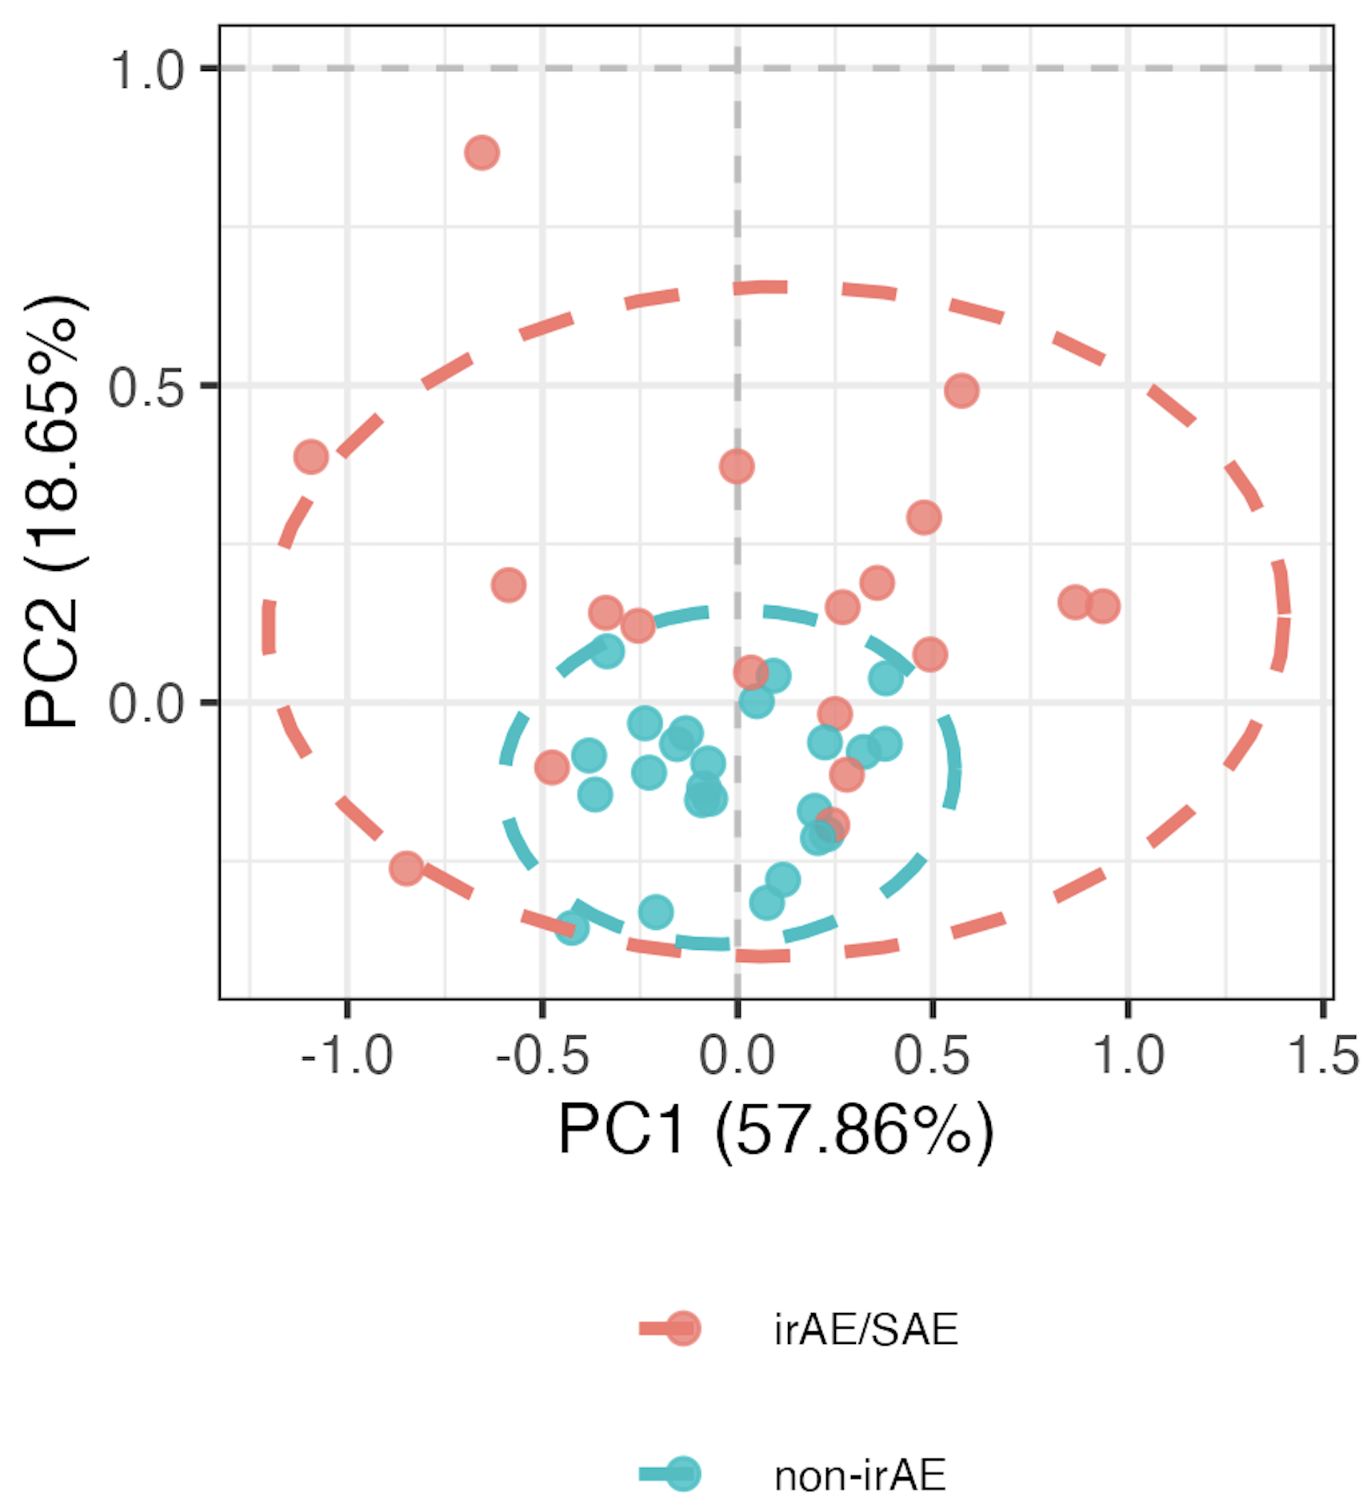
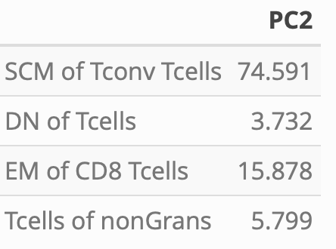
Distinguishing combined irAE group using module of top 4 combined irAE baseline features
PC2 contributions
PC2 **
**: p < 0.01

Slide 18
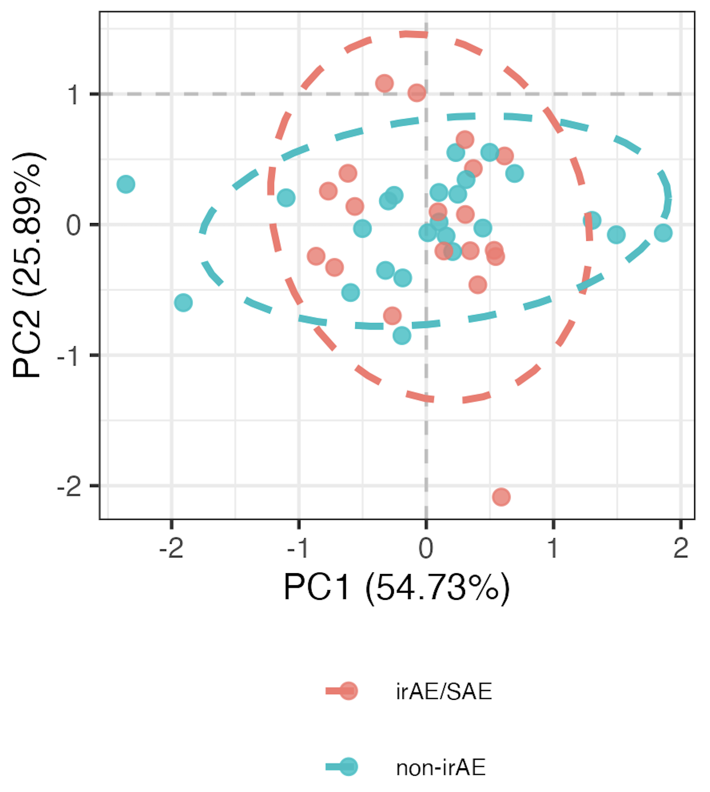
Using randomly formed modules instead
- choosing random set of 4 features 1000 times, obtain similar separation in PCA space ~4.1% of the time
“bottom” 4 feature
module
Notes:
Pvals > 0.9 here for PCs 1-3
> 1 p < 0.01 in PCs 1-3 here for 4% fig
4.1% translates to pval 0.041 (Monte carlo pval)?
SCM feature most common in sets of 4 that hit significance, not surprisingly given it’s a borderline pval itself…

Slide 19
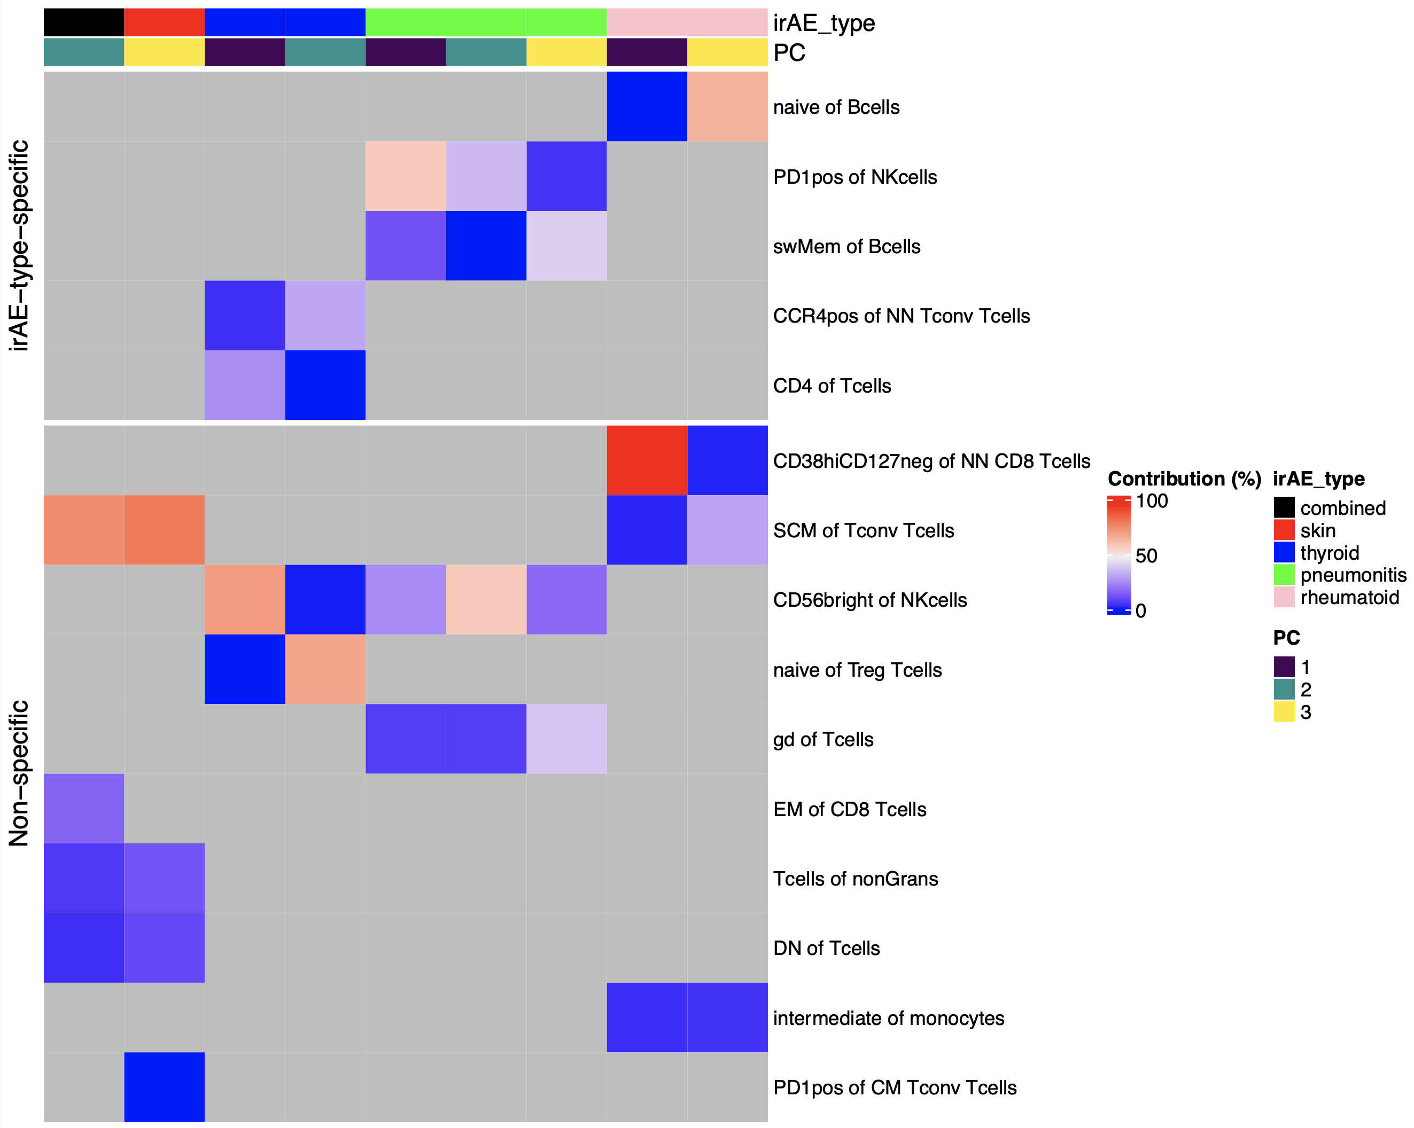
Summary of baseline module analyses: several features may be more irAE-type-specific
Notes:
Worth raising concern of overfitting to our data (i.e. subsetting features ~arbitrarily), but the non-specific features with literature evidence are perhaps more backed up here (less biased by noise)
Only showing PCs with p < 0.05 for group comparison

Slide 20
Main goals
Identify immune cell biomarkers that predict irAEs
Determine how ICI alters immune cell landscape
Does ICI make immune landscape more like that seen in individuals with natural autoimmunity, specifically in those who develop irAEs?
What immune cell subsets change in irAE-specific manner on ICI?

Slide 21
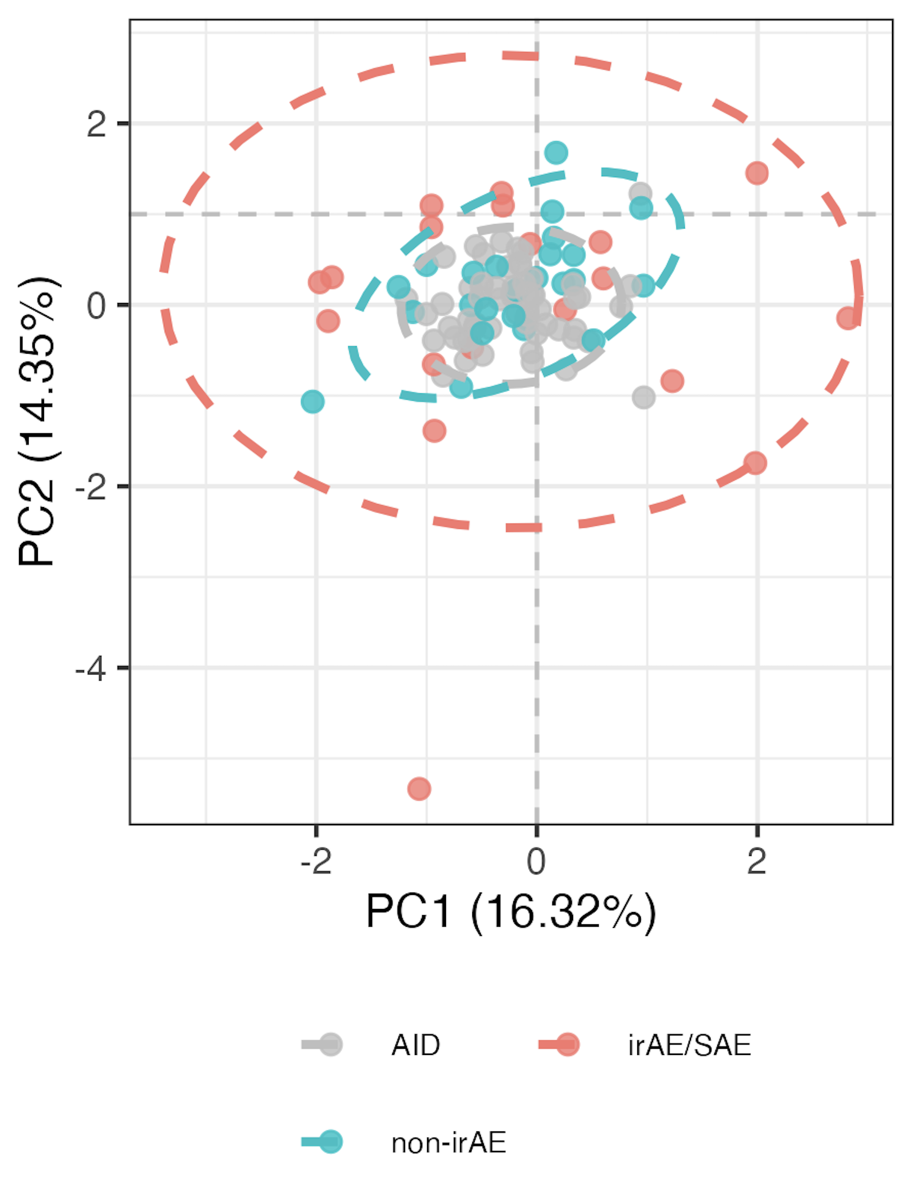
Methods for determining if irAE group immunotypes become more like those of AID patients over ICI
Remove PD1⁺ features
Run PCA on all autoimmune and cancer (longitudinal) patient data
Find centroids of autoimmune and baseline cancer data (for irAE/no irAE groups)
Define a line between baseline cancer centroids (irAE/no irAE ones) to autoimmune centroid
Project longitudinal immunotypes onto line (more positive then means closer to AID immunotype)

Slide 22
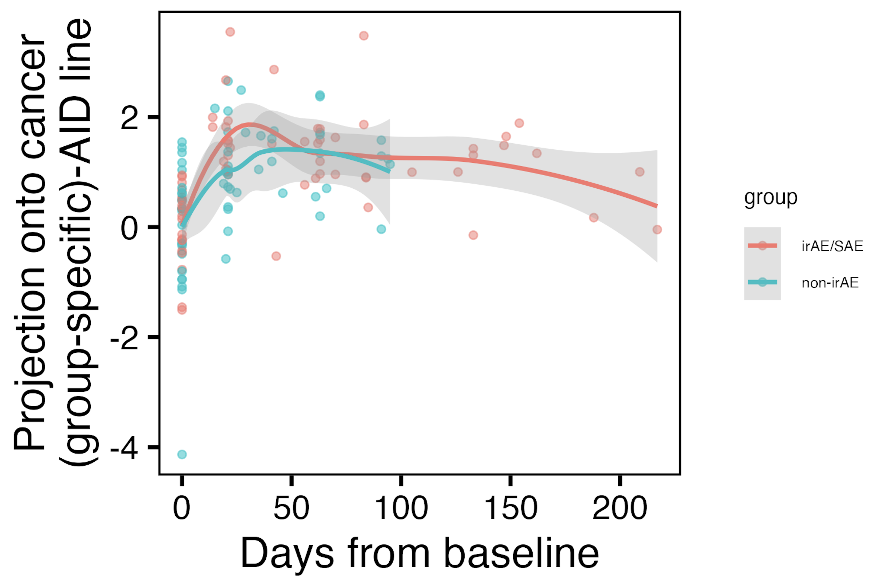
Immunotypes of irAE group may become more “AID-like” early over ICI than those of non-irAE group
Do stats on this
Notes:
Left is PCA of all AID/cancer (longitudinal) data, just showing baseline data though
Right: positive means closer to AID centroid

Slide 23
Main goals
Identify immune cell biomarkers that predict irAEs
Determine how ICI alters immune cell landscape
Does ICI make immune landscape more like that seen in individuals with natural autoimmunity, specifically in those who develop irAEs?
What immune cell subsets change in irAE-specific manner on ICI?

Slide 24
Methods to identify immune cell subsets changing over ICI in irAE group-specific manner
Remove PD1⁺ features
For each feature
Model relationship between feature frequency and time (since baseline) with or without interaction between irAE group and time (bolded)
Run ANOVA on two models to see if including interaction term improves model fit
model <- gam(freq ~ irae_group +
s(days_from_baseline, k = 5, bs = "cr", by = irae_group) +
s(patient_id, bs = "re"), data = data, method = 'REML')
Notes:
If model fit improves with interaction term, that means that the effect of time on ICI on feature frequency is different between irAE groups
REML (Restricted Maximum Likelihood) is a statistical technique used for parameter estimation, particularly in mixed-effects models and generalized additive models (GAMs)
The key idea is to determine if adding the interaction term between rheumatoid_irae and days_from_baselinesignificantly improves the model fit. The specific ANOVA test being used here is the likelihood ratio test (via test = "Chisq"), which tests whether the more complex model (model_interaction) explains significantly more variance than the simpler model (model_no_interaction).
Null hypothesis: The model without interaction (i.e., the simpler model) fits the data as well as the model with the interaction.
Alternative hypothesis: The model with the interaction term fits the data significantly better than the model without it, suggesting that the effect of days_from_baseline differs between groups.

Slide 25
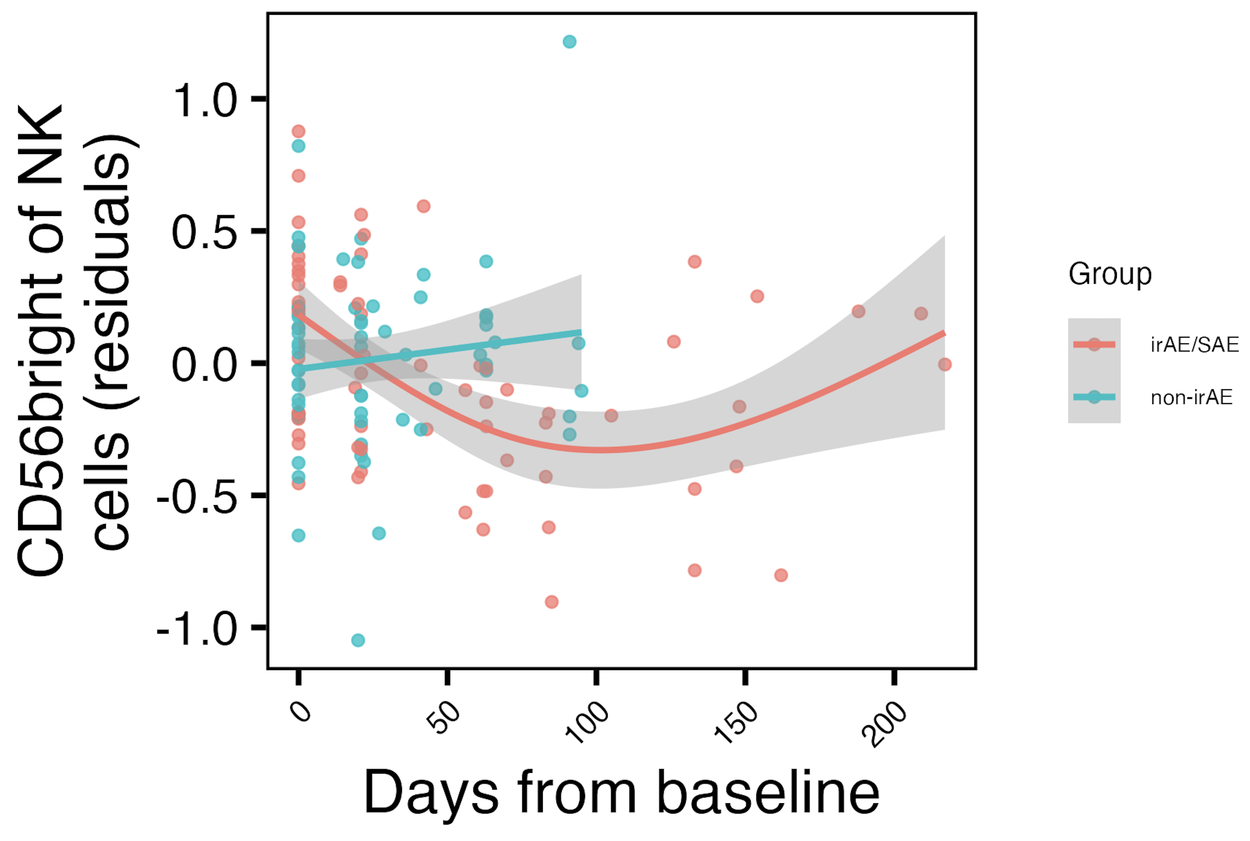
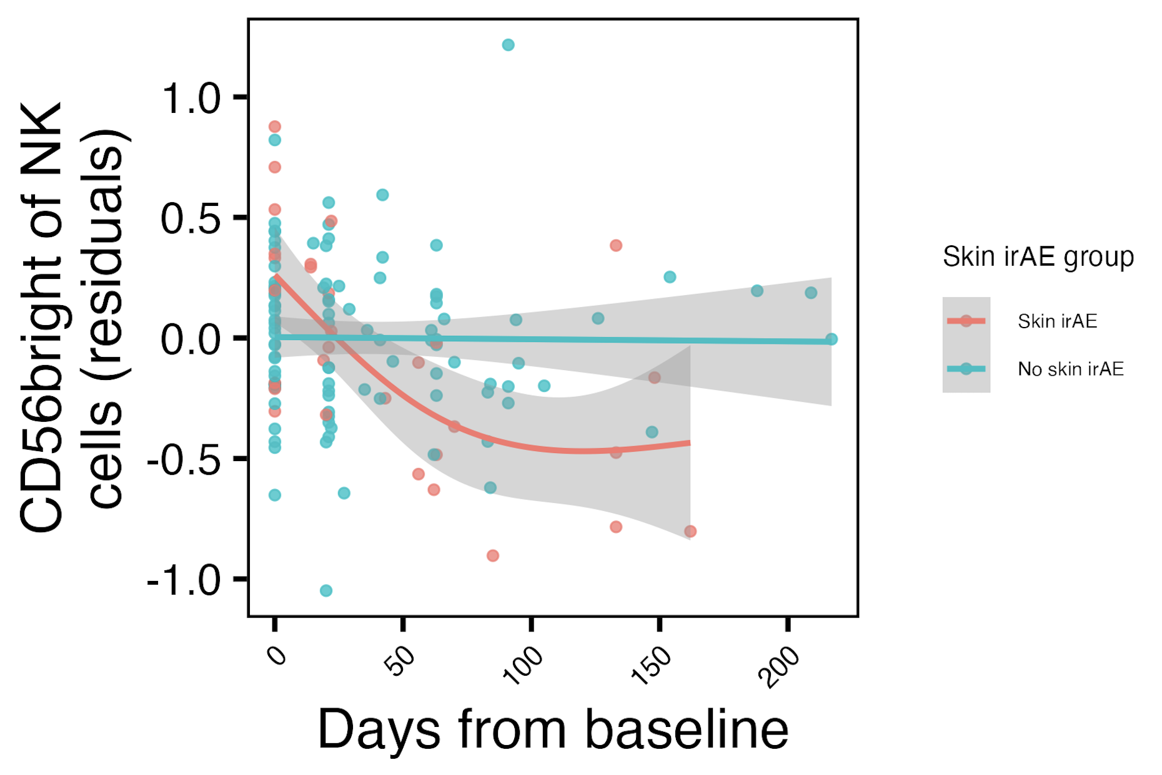
Frequency of CD56^{bright} of NK cells initially decreases with ICI specifically in combined irAE and skin irAE groups
**
*
CD56^{high} NK of non-granulocyte frequency reported lower in severe irAE patients at irAE time (Kovacsovics-Bankowski et al. J Immunother Cancer. 2024)
**: padj < 0.01, *: padj < 0.05
Notes:
Note that remember from cohort metadata plot most irAEs arise within 1-2 months, so that’s within early timing here where we see differences
matches finding from Kovacsovics-Bankowski et al. J Immunother Cancer. 2024 (lower CD56high NK of non-gran in patients at irAE max), surprisingly despite their cohort was mostly not pulmonary irAE and was mostly melanoma!

Slide 26
Conclusions
Baseline analyses
CD56^{bright} of NK cells frequency higher, PD1⁺ of NK cells frequency lower in those developing pneumonitis
SCM of T_{conv} T_{cells}
frequency may be lower in those developing irAEs
important feature in module for distinguishing combined irAEs
Longitudinal analyses
immunotypes of irAE group may become more “AID-like” early over ICI than those of non-irAE group
CD56^{bright} of NK frequency initially decreases with ICI in skin/combined irAE groups
Some features may be more irAE-type specific
why subsets irae type specific?
Notes:
irAE-type-specific features, like CD56bright/PD1+ of NK for pneumonitis (and SCM of Tconv being more general maybe for combined irAE)

Slide 27
Speculative model
Fill in
like for longitudinal presumably ICI affects PD1+ subsets and differences in how this happens leads to iraes perhaps (as shown here) through effects mediated by other cell types like cd56 bright who themselves are affected by the initial pd1 affecteds. for baseline its easier to just say protective/antonym

Slide 28
Next steps
IMPACD to look at more granular cell subsets
Test results in public datasets
Clarify what IMPACD will offer in case of Qs
i.e. currently % of parent but what will IMPACD do/offer…
Notes:
Alice W. working on single-param gates to send my way
Public data test is likely ~complicated by needing similar cohorts to see same effects
But public data test would be very important given concerns of overfitting… for the module analysis

Slide 29
Inhibitory immune checkpoints help maintain self tolerance
Khan et al. Semin Cancer Biol. 2020
Notes:
Script:
Immune checkpoint molecules are ligand-receptor pairs that exert stimulatory or inhibitory effects on the immune response
Inhibitory checkpoints are crucial for maintaining self-tolerance and modulating the duration and magnitude of the immune response to minimize tissue damage
CTLA-4 and PD-1/PD-L1 are the most widely studied inhibitory checkpoint molecules.
CTLA-4 outcompetes CD28 (costimulatory receptor) for B7-1/2 ligands on APCs to increase threshold for T cell activation (i.e. reduces immune responses to weak antigens, self/tumor)
PD-1 expressed by activated/induced T cells; this checkpoint prevents inappropriate overactivation and limits duration of T cell activation

Slide 30
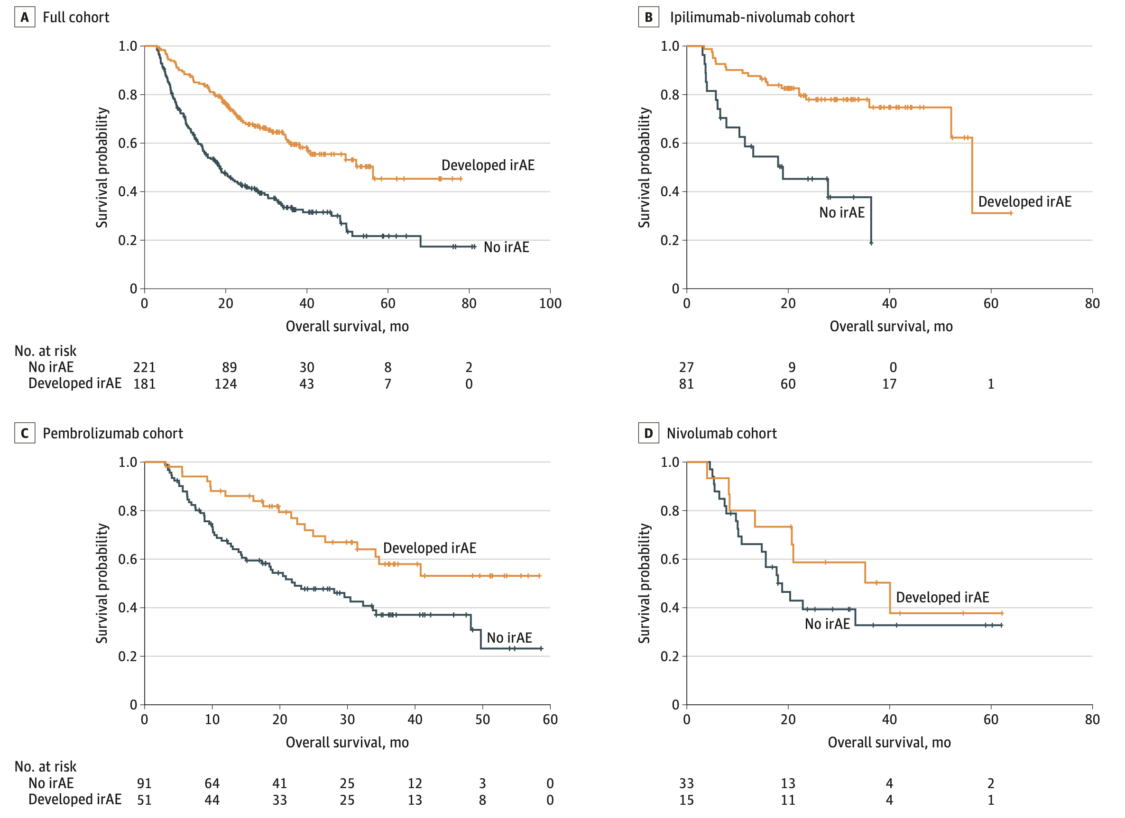
irAE development is associated with anti-tumor response (PMID31021392, PMID26501224, PMID26446948)
Watson et al. JAMA Netw Open. 2022
Notes:
Association of checkpoint inhibitor-induced toxic effects with shared cancer and tissue antigens in non-small cell lung cancer:
irAEs associated with response to therapy (also can cite Association of vitiligo with tumor response in patients with metastatic melanoma treated with pembrolizumab), also Nivolumab in resected and unresectable metastatic melanoma: characteristics of immune-related adverse events and association with outcomes
Characterization of anti-cancer immune response associated with immune-related adverse events in patients with kidney cancer (meeting abstract)
- more irAEs in ICB responders, not a new finding

